Slide 1
UTSA Cyber Security Ecosystem
Ravi Sandhu Executive Director Professor of Computer Science Lutcher Brown Chair in Cyber Security
iArpa Briefing, UTSA Campus December 11, 2018
ravi.sandhu@utsa.edu www.ics.utsa.edu www.profsandhu.com

Slide 2
Cyber Security at UTSA
A strategic priority since 2000
ACADEMIC UNITS
College of Sciences
College of Business
College of Engineering
College of Liberal and Fine Arts
College of Education and Human Development
School of Data Science
RESEARCH CENTERS
Institute for Cyber Security
Center for Infrastructure Assurance and Security
Cyber Center for Security and Analytics
Open Cloud Institute
National Security Collaboration Center
NSA/DHS CERTIFICATIONS
Center of Academic Excellence in Cyber Defense Education
Center of Academic Excellence in Cyber Defense Research
Center of Academic Excellence in Cyber Operations
http://www.utsa.edu/spotlights/cybersecurity/

Slide 3
ICS Mission and History
MISSION
Sustained excellence in graduate-level sponsored research
2007-2012
Founded by start-up funding from State of Texas
2012-2017
Graduated to a self-sustaining operation
2017-2022
Major expansion by winning NSF C-SPECC grant
Situated in the College of Sciences, Department of Computer Science
Established world class laboratories for: Secure cloud computing Malware research
In collaboration with:
College of Engineering
College of Business
College of Education
Open Cloud Institute
Cyber Center for Security & Analytics
Partnership with 4 NISD High Schools:
Harlan, Woodson, Taft, Business Careers

Slide 4
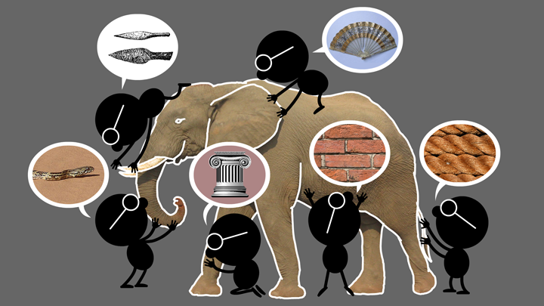
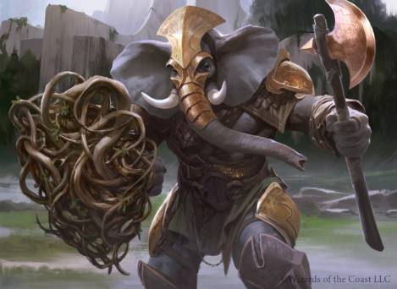
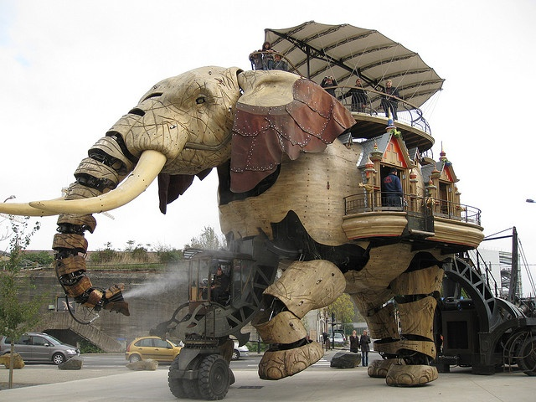
Natural vs Cyber Science
Elephant Problem
Cyber-Elephant Problem
The cyber-elephant problem requires Applied and Basic research Combined (ABC)
* The New ABCs of Research, Ben Schneiderman, 2016

Slide 5
Cyber Security Landscape
Objectives
POLICY
ATTACKS
Enable
What?
Why?
Respond
Enforce
Defend
PROTECT
How?
DETECT
Mechanisms
Complement

Slide 6
Research Approaches
Divide and Conquer
Develop point solutions to point problems
Compose and Compensate
Build system level solutions from smaller component solutions
Bright
Shiny
Objects
Hard Unapproachable Problems

Slide 7
ICS Research Philosophy
Applied and Basic Research Combined (ABC)
Software: Waterfall -> Agile and DevOps
Security: Waterfall -> ???
Tech transfer: Technology Readiness Levels (TRLs) -> ???
* The New ABCs of Research
by Ben Schneiderman, 2016

Slide 8
ICS Major Research Thrusts
TECHNOLOGIES
Access Control
Policy
Malware
Detection and Forensics
Blockchain
Artificial Intelligence/ Machine Learning
….
APPLICATION DOMAINS
Cloud Computing
Internet of Things (IoT)
Social Networks
Big Data
Mobile Platforms
Enterprise
….
Goal: Broaden and Deepen

