Slide 1
Analyzing and Exploiting
Network Behaviors of Malware
Jose Andre Morales Areej Al-Bataineh
Shouhuai Xu Ravi Sandhu
SecureComm
Singapore, 2010

Slide 2
Introduction
Do malicious and benign processes behave differently from a networking perspective?
Can we exploit these differences to identify malware, especially zero-day attacks?
Analyzed 1000 malware samples, with 31 not detected by Virustotal.com 01 April 2010 and 123 benign samples
Focus on DNS, NetBIOS, TCP, UDP, ICMP

Slide 3
Introduction - 2
Log file analysis tallied various network event occurrence amounts
Along with traffic observations we identified behavior occurring mostly in malware
Defined 7 behaviors dealing with specific observed anomalies in network traffic
Some behaviors combine network events to form an anomaly
These behaviors used to differentiate between malicious and benign processes
Clustering and classification

Slide 4
Contributions
Identification of network behaviors occurring mostly in malware usable in behavior based malware detection.
Discovery of novel malicious uses of network services by malware.
Evaluating the effectiveness of observed network behaviors in identifying malware and benign processes with clustering and classification.

Slide 5
7 Behaviors
B1: Process performs a NetBIOS name request on a domain name that is not part of a DNS or rDNS query
B2: Failed connection attempt to an IP address obtained from a successful DNS query
B3: Failed connection attempt to the input IP address of a successful rDNS query
B4: Connection attempt to the input IP address of a failed rDNS query

Slide 6
7 Behaviors
B5: ICMP only activity, ICMP echo requests for a specific non-local network IP address with no reply or a returned error message.
B6: TCP/ICMP activity, TCP connection attempts to non-local IP addresses that received a successful reply to their ICMP echo requests
B7: Network activity that is rarely occurring or implemented in an anomalous manner

Slide 7
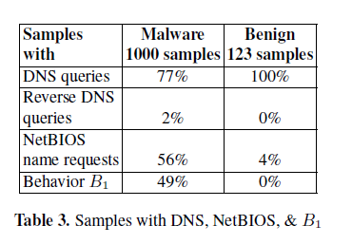
Behavior B1
Process performs a NetBIOS name request on a domain name that is not part of a DNS or rDNS query
Table shows B1 occurring only in malware, benign NetBIOS used domain names previously used in a DNS query.
Several domains in B1 known malicious by Malwareurl.com but others were not

Slide 8
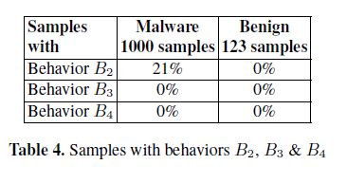
Behaviors B2, B3 & B4
DNS often used to acquire IP addresses
Only B2 occurred, many malware DNS domain names and cannot connect with returned IP, either offline or shutdown, or newly registered and inactive
B3, B4 no occurrence, possible less favored by malware authors

Slide 9
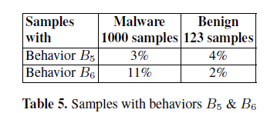
Behaviors B5 & B6
ICMP used by malware (like PING) to acquire active IP addresses, these IPs not part of previous DNS, rDNS or NetBIOS → suspicious behavior. B6 dominant in malware
B5 almost same in both, very similar to DNS behavior with no request reply

Slide 10
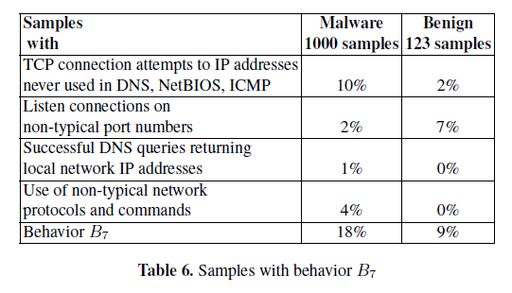
Behavior B7
Considered suspicious but not necessarily malicious, behaviors were rarely occurring or implemented in non-conventional manner
TCP connection attemps most prevalent, IP not acquired via DNS, NetBios or ICMP, possibly hardwired or dynamically generated

Slide 11
Behavior Evaluation
1000 malware samples from CWSandbox 27 October 2009 upload, diverse set, still active durng testing.
  31 samples from 31 March 2010 upload not detected by Virustotal.com (MD5 search) 1 April 2010
41 benign samples executed 3 times each = 123 total benign samples – FTP, RSS, socnet, P2P, AV, net tools
Individual samples run for 10 minutes in VMWare (XP SP2) using Windows network monitor, proprietary netwok layer filters
Results revealed behaviors differentiate malicious from benign including 31 unidentified malware

Slide 12
Clustering & Classification - 01
Weka data mining software
Clustering used complete malware and benign data set
Classification training set used 1st 700 malware samples and 40 benign, testing used the remaining samples
31 unknown samples not part of training set

Slide 13
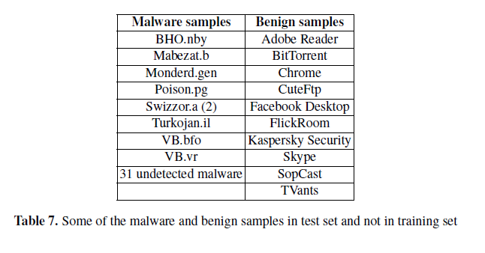
Clustering & Classification - 02

Slide 14
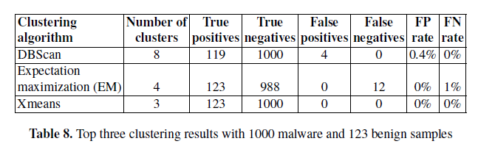
Clustering Results
If majority of cluster was malware then benign samples assumed FP, If majority of cluster was benign then malware samples assumed FN
Xmeans perfect, DBScan & EM encouraging
  All 31 unknown malware correctly identified
FP video streamers known to be unreliable networks
EM FN mostly malware downloaders

Slide 15
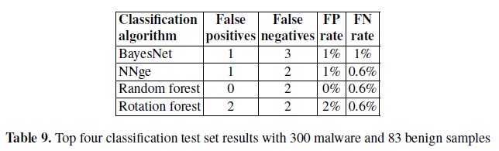
Classification Results
FN and FP very low, 2 malware flagged as FN by all 4, only 2 video streams flagged as FP
29 unknown malware correctly identified by all 4

Slide 16
Discussion
B1, B2 & B7 most dominant behaviors
B1,B5 & B6 considered novel behaviors used by malware to find active remote hosts
Classification & clustering produced excellent results with minimal FN & FP
31 malware not identified by virustotal.com on 1 April 2010 were correctly detected with minimal exceptions

Slide 17
Conclusions
Network behaviors can be exploited to differentiate between malicious and benign
Discovered 3 novel network behaviors
Our approach can be combined with other perspectives to enrich detection accuracy
The behaviors detected a diverse set of malware inlcuding 31 unknown samples with minimal FP and FN

