Slide 1
Towards Secure Information Sharing Models for Community Cyber Security
Ravi Sandhu, Ram Krishnan and Gregory B. White
Institute for Cyber Security
University of Texas at San Antonio

Slide 2
Secure Information Sharing (SIS)
Share but protect
Saltzer-Schroeder¹ identified the desirability and difficulty of maintaining:
“some control over the user of the information even after it has been released”
¹J. Saltzer and M. Schroeder. The protection of information in computer
systems. Proceedings of IEEE, 63(9):1278–1308, 1975.

Slide 3
SIS Major Challenges
Policy Challenge
Modeling, specifying and enforcing SIS policies
Need intuitive yet formal models, guaranteed security properties, etc.
Containment Challenge
Ensure that protected information is accessible to users as permitted by the policy
Security mechanisms such as authentication, cryptography, trusted hardware, etc.

Slide 4
Community Cyber Security
Community refers to a geographical area
E.g. county or a city with demarcated boundary
The Center for Infrastructure Assurance and Security at UTSA conducts nation-wide cyber security preparedness exercises and training
communication
incident response
disaster recovery
business continuity
security awareness, etc.

Slide 5
The Current Status…
Exchange of business cards
No process exists for information sharing
Technology is not the bottleneck
Resistance due to political/competitive reasons
Also want to avoid embarrassment
E.g. by sharing attack data
Participants have no clue as to what to share and how to effectively specify what to share

Slide 6
Requirements
Need abstract models
With rigorous mathematical foundations
Should ease administration
Classic models are limited
Discretionary Access Control
Too low-level to configure
Lattice-Based Access Control (E.g. Bell LaPadula)
Rigid
One directional info flow is not the primary concern
Lot of work on Dynamic Coalitions
Many times heavy-weight
Mainly focus on technological/infrastructural integration

Slide 7
Life-Cycle of a Cyber Incident Secure Sharing in a Community
Filtered RW
Administered Membership
Core Group
Incident Group
Conditional Membership
Automatic Membership
Administered Membership
Administered Membership
Open Group
Filtered RW
Domain Experts

Slide 8
Life-Cycle of Cyber Incident Secure Sharing in Community (contd)
Incident Groups
Conditional Membership
g1
Administered Membership
Core Group
Filtered
Read
Domain Experts
Automatic Membership
Conditional Membership
Administered Membership
Open Group
g2
Conditional Membership
Filtered
Write
Administered Membership
g3

Slide 9
A Family of Group-Centric SIS Models
Isolated
Users and objects are isolated
Membership in one group has no impact on authorizations in another group
Connected
Membership in one group impacts authorization in another
E.g. Subordination, conditional membership, mutual exclusion, etc.
Attribute-Based Access Control
For fine-grained authorization
Connected + ABAC
g-SIS Models
Isolated
+
ABAC
Connected
Isolated

Slide 10
Conclusion
SIS is still an open problem
Technology is relatively under control
Policy specification is key to SIS
Clear, usable and friendly policies can overcome political and competitive barriers to SIS
One size does not fit all
Domain and application specific modeling and analysis is needed

Slide 11
Backup

Slide 12
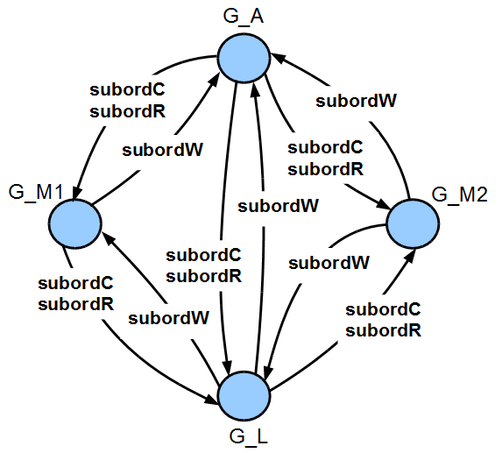
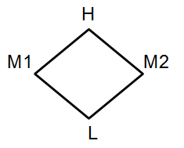
g-SIS and LBAC
Read Subordination
Write Subordination
Subject Create Subordination
A sample lattice for one directional information flow
Equivalent g-SIS configuration of Org A lattice

Slide 13
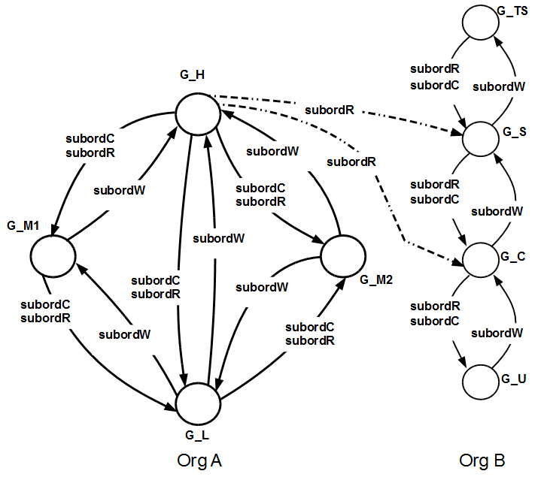
Agile Collaboration
Read Subordination
Write Subordination
Subject Create Subordination
Agile collaboration in LBAC enabled by g-SIS

Slide 14
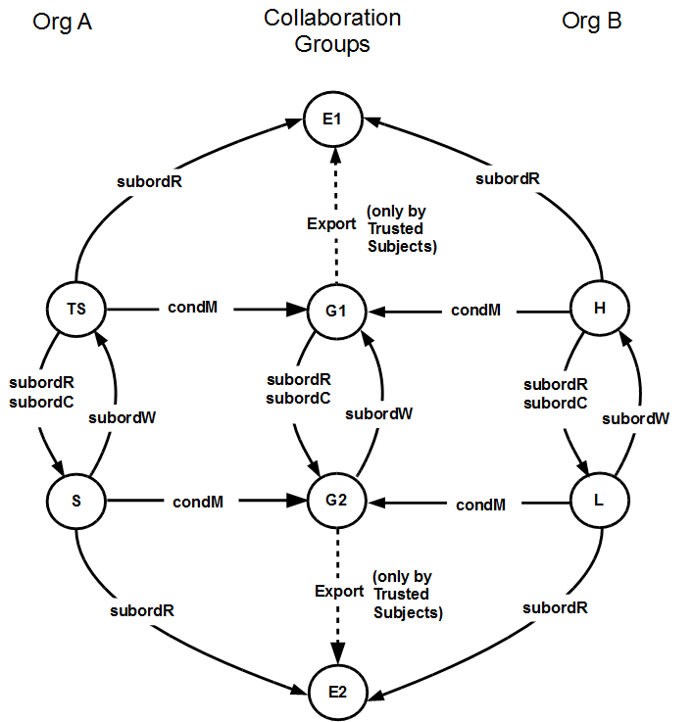
Agile Collaboration (continued)
Read Subordination
Write Subordination
Subject Create Subordination
Collaboration groups established between two different lattices

Slide 15
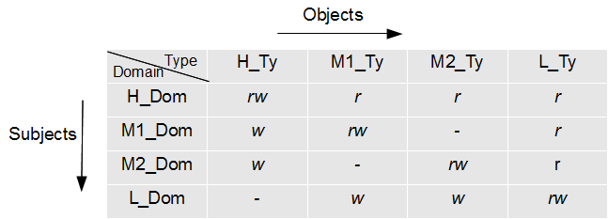
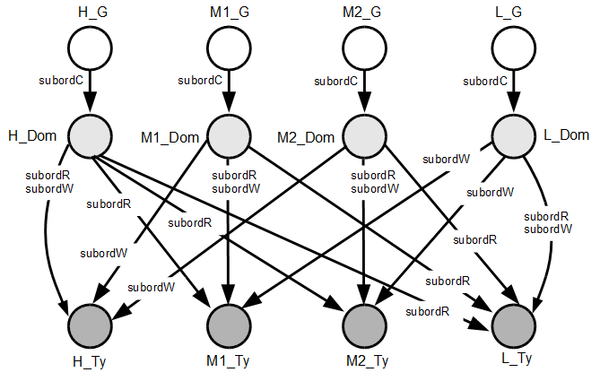
Domain and Type Enforcement and g-SIS
A sample DTE matrix
Equivalent g-SIS configuration
Read Subordination
Write Subordination
Subject Create Subordination

Slide 16
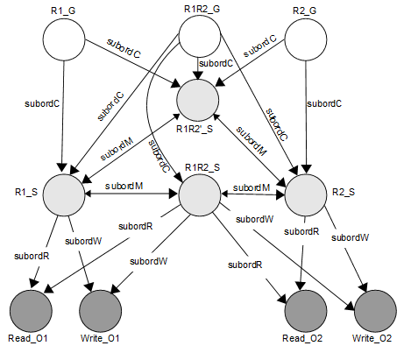
RBAC₀ and g-SIS
Read Subordination
Write Subordination
Subject Create Subordination
Subject Move Subordination
RBAC₀ with RW permissions in g-SIS

