Slide 1
Towards A Framework for Cyber Social Status Based Trusted Open Collaboration
Oct. 9, 2010
Jaehong Park, Yuan Cheng, Ravi Sandhu
Institute for Cyber Security
University of Texas at San Antonio

Slide 2
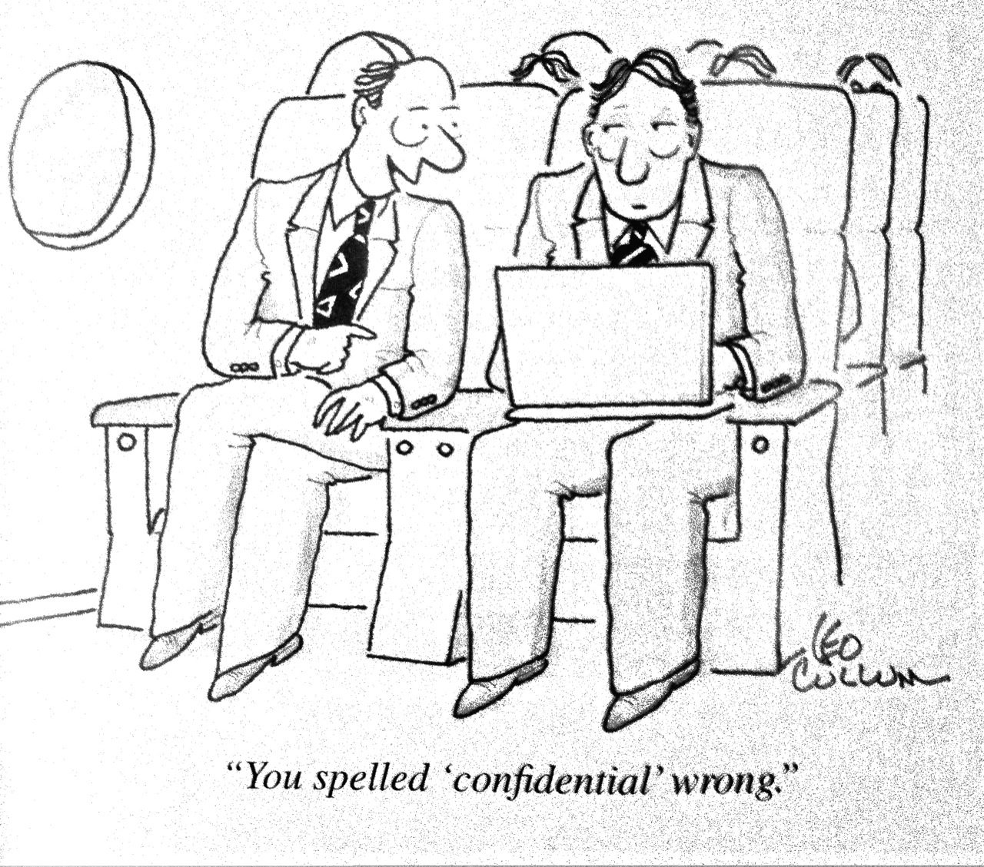
Open Collaboration?

Slide 3
Collaboration
Closed Collaboration
  Information and resource sharing amongst selected participants
Open Collaboration
  Anyone can participate
  Proven to be productive
  Inherently a social activity, hence trust establishment needs a social computing

Slide 4
Trusted Collaboration
Trusted Closed Collaboration
  Trustworthiness of selected users and shared resource is verified
Trusted Open Collaboration (TOC)
  NOT MEAN an open collaboration system with a guaranteed trustworthiness
  MEANS a discriminative measure (for example, cyber social status in our case) can be facilitated in open collaboration to provide certain degree of trust to participants.

Slide 5
Open (source) Collaboration Principles
Egalitarian
  Everyone can contribute, because open source projects are accessible on the Internet and the project community is typically inclusive to anyone who wants to help.
Meritocratic
  Contributions are judged transparently and based on their merits. All decisions are discussed publicly on mailing lists and can be looked up for reference.
Self-organizing
  There is typically no defined process imposed from the outside so the project community itself determines how to go about its work.
By Dirk Riehle et al. “Bringing Open Source Best Practices into Corporations.” IEEE Software, 2009

Slide 6
TOC: Three Principles
Egalitarian
  user with equal footing
  anyone can participate (contribute and get benefit)
  No user account or anyone can create an account
  Not necessarily means all contributions are valued equally
Meritocratic
  contribution-based weighted value of user and resource
  True only to a certain degree since
    Contribution-based discriminative social standing can allow a user to influence other users’ social standing
    Social standing can be given by authority or other social activities, not by contribution (or merit)
Discriminative
  Trust is based on selective discrimination of participants and resources
  Discrimination is based on various cyber social statuses

Slide 7
TOC: Two Criteria
Contribution evaluation process
  Self-organized
    Collaboration community decides the process (No pre-imposed process from outside)
  System-organized
    Evaluation process can be pre-imposed by system
    E.g., In wiki, the system may allow an expert to delete other’s shared resource
Cyber Social Status (CSS) management
  Self-governed
    Collaboration community itself (participants’ activities) generates and manages CSS
    User participation in governing social status and social activity
  Authority-governed
    CSS is given by an authority who is not a participant

Slide 8
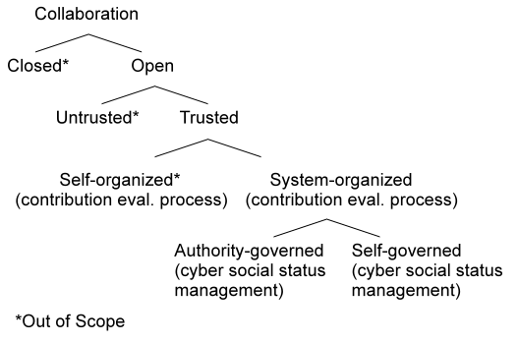
Collaboration Taxonomy

Slide 9



User Cyber Social Status (u-CSS)
Authority-given
User-claimed
User CSS-based

Slide 10



User Cyber Social Status (u-CSS) – cont.
Resource CSS-based
User-participation-based
Collaborated Social Activity (CSA)-based

Slide 11



Resource Cyber Social Status (r-CSS)
Authority-given
User-claimed
User CSS-based

Slide 12


Resource Cyber Social Status (r-CSS) – cont.
Resource CSS-based
Collaborated Social Activity (CSA)-based

Slide 13
Characteristics of u-CSS Types
CSS Type | CSS Governing | Meritocracy | CSS Vulnerability
Authority-given | authority | Not meritocratic | No Sybil Attack
User-claimed | Self or other user | Not meritocratic | If self, no Sybil Attc. If other, depends on difficulty of user claiming
User CSS-based* | Depends on added CSS type | No, alone. Meritocratic w/ CSA-based u-CSS | No Sybil Attack alone
Resource CSS-based | users | Meritocratic w/ CSA-based r-CSS | Vulnerable if r-CSS can be generated by CSA
User participation-based | self | limited meritocratic (no others’ eval.) | No Sybil Attack
CSA-based | users | Meritocratic | Vulnerable to Sybil Attack
*Needs other u-CSS type(s)

Slide 14
Characteristics of r-CSS Types
CSS Type | CSS Governing | Meritocracy
Authority-given | authority | Not meritocratic
User-claimed | User | Not meritocratic
User CSS-based | User | Not meritocratic
Resource CSS-based* | Depends on additional r-CSS type | Meritocratic w/ CSA-based r-CSS
CSA-based | Users | Meritocratic
*Needs other r-CSS type(s)

Slide 15
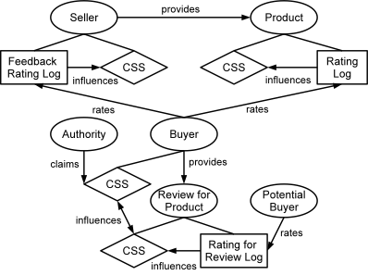
Amazon-like TOC
CSS Types used:
CSA-based uCSS/rCSS
uCSS-based rCSS
rCSS-based uCSS
Authority given uCSS

Slide 16
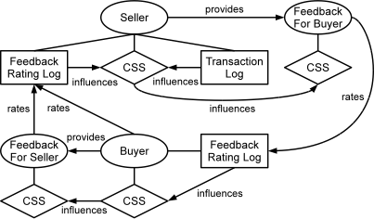
eBay-like TOC
CSS Types used:
CSA-based uCSS
uCSS-based rCSS

Slide 17
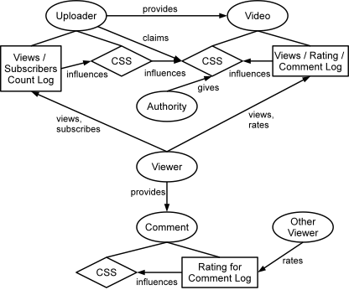
YouTube-like TOC
CSS Types used:
CSA-based uCSS/rCSS
uCSS-based rCSS
User-claimed rCSS
Authority given rCSS

Slide 18
Questions? Comments?

