Slide 1
Symptoms-Based Detection of Bot Processes
Jose Andre Morales Erhan Kartaltepe
Shouhuai Xu Ravi Sandhu
MMM-ACNS – St Petersburg, Russia 2010

Slide 2
Introduction
Botnets (centralized & P2P): spam distribution, DoS, DDos, unauthorized FTP, etc.
Bot masters lease their botnets = $$$$$$$
Current research focuses on detecting infected bot machines but not the actual process on that machine
This is good for botnet identification but for disinfection, process information is mandatory

Slide 3
Introduction - 2
We attempt to fill this gap by identifying the actual bot process running on compromised machines with behavior based detection of bot/malware symptoms
We study the execution behavior of known bot samples and attempt to distinguish characteristics exclusive to a bot and/or malware process
We partition the behaviors into symptoms as basis of detection algorithm: Bot network behavior, Unreliable provenance and Stealth mechanisms
Use data mining algorithms along with logical evaluation of symptoms to detect bots

Slide 4
Contributions
The process-based identification of:
  Bot network behavior, Unreliable provenance, Stealth mechanisms:
A formal detection model based on non-trivial use of established data mining algorithms (C4.5).
  Generate and evaluate detection models. Results show our methodology has better detection accuracy for both centralized and Peer-to-Peer (P2P) bots than a straightforward use of established data mining algorithms.

Slide 5
Observed Behaviors
B(P) Bot Network: tcp, udp, icmp, dns usage
U(P) Unreliable provenance: process self replication and dynamic code injection, & verified digital signature
S(P) Stealth mechanisms: lacking a GUI & no user input to execute
Analyzed in real time

Slide 6
Bot Behavior Symptoms
DNS/rDNS highly used by bots to:
  Locate active remote hosts, harvest new IP addresses
  Successful DNS/rDNS should connect, failed should not
  Bots may depend on DNS for botnet activity
B1: Failed connection attempt to the returned IP address of a successful DNS query.
B2: IP address in a successful DNS activity and connection. This is considered normal behavior.
B3: Connection attempt to the input IP address of a failed reverse DNS query.

Slide 7
Unreliable Provenance Symptoms
Most malware lack digital signatures, self replicate and dynamically inject other running processes with malicious code
U1: Standalone executable’s static file image does not have a digital signature.
U2: Dynamic code injector’s static file image does not have a digital signature.
U3: Creator of process’s static file image does not have a digital signature.

Slide 8
Stealth Mechanism Symptoms
Malware execute in “silent” mode requiring no user interaction: no GUI & no user input
S1: Graphical user interface. A process executing without a GUI
S2: Human computer interface. A process executing without reading keyboard or mouse events is considered to have a stealth mechanism.

Slide 9
Evaluation
Four symptom evaluations to predict a bot: Bot(P) -> T or F
Bot( ) constructed by function f as follows:
  f0: established data mining algorithm → J48
  f1: B(P) or (U(P) and S(P))
  f2: B(P) and (U(P) or S(P))
  f3: B(P) and U(P) and S(P)
F3 most restrictive requiring all three symptoms present to identify a bot
Evaluations partially based on J48 classification trees

Slide 10
Data Collection – Training Set
Vmware workstation: XP-SP2; Windows network monitor, sigcheck, various hooking techniques, 20 bot & 62 benign processes
4 active bots: virut, waledac, wopla & bobax
5 inactive bots: nugache, wootbot, gobot, spybot & storm
41 benign applications
Bots executed for 12 hour period, results drawn from post analysis of log files
Benign data collected on two laptops 12 hour period: FTP, surfing, P2P, instant messaging and software updates
Bots and benign samples executed multiple times

Slide 11
Data Collection – Test Set
Test data collected on 5 laptops
  Minimal security
  No recent malware scans
  8 to 12 hours
Post scan malware analysis revealed two bot processes
  Cutwail bot: servwin.exe
  Virut bot: TMP94.tmp
Cutwail bot not part of training set
Test set consisted of 34 processes including 2 bot processes, the rest were assumed benign
Several benign processes not part of training set

Slide 12
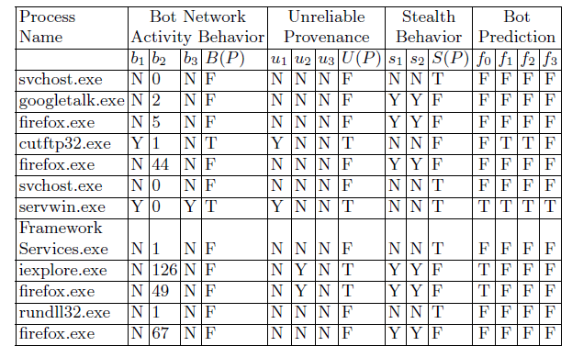
Bot Predictions

Slide 13
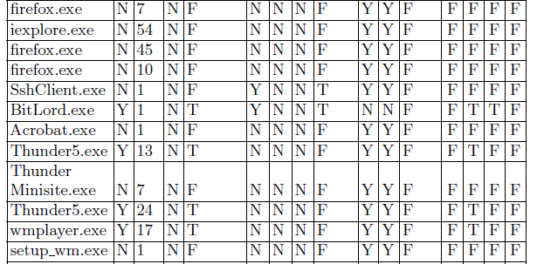
Bot Predictions

Slide 14
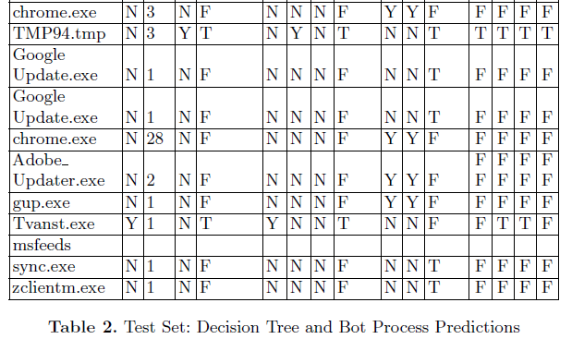
Bot Predictions

Slide 15
Prediction Results
f0: simplistic use of J48 classifier; 2 FP, 0 FN.
f1: least restrictive; 6 FP, 0 FN.
  B(P) or (U(P) and S(P))
f2: more restrictive; 3 FP, 0 FN
  B(P) and (U(P) or S(P))
f3: most restrictive; 0 FP, 0 FN
  B(P) and U(P) and S(P)

Slide 16
Discussion
FP were a mix of browsers, FTP, video streamers, P2P & torrent clients
Both bots in test set detected by all 4 functions. The different functions f only served to eliminate FP
F3 gave the best results by eliminating all FP, suggesting a high restriction can improve results in bot detection
F1 & F2 with weaker restrictions produced more false positives but may be applicable in detecting non-bot malware
Symptoms B1, B2, U1, U2 & S1 used in final bot prediction; S1 most dominant with 13 processes
  Several benign samples were system services running in background

Slide 17
Conclusion
Presented 3 sets of symptoms usable in detecting bot processes
Enhances current research which focuses most on bot machines
Results drawn from real time data collection
Most restrictive evaluation most suitable for bot detection, but combining with less restrictive may detect broader range of bots and non-bot malware
Future Work: identify more symptoms, test with kernel based bots and implement automated detection techniques

Slide 18
THANK YOU !
QUESTIONS?
вопрос

