Slide 1
SDN-RBAC: An Access Control Model for SDN Controller Applications
Abdullah Al-Alaj¹, Ram Krishnan² and Ravi Sandhu¹
¹Dept. of Computer Science
²Dept. of Electrical and Computer Engineering
^{1,2}Institute for Cyber Security
^{1,2}Center for Security and Privacy Enhanced Cloud Computing (C-SPECC)
University of Texas at San Antonio, TX 78249
4th IEEE International Conference on Computing, Communication and Security (ICCCS’2019)
Rome, Italy, October 10-12, 2019

Slide 2
Agenda
Introduction
Access Control for SDN
SDN-RBAC Model
App Sessions in SDN-RBAC
SDN-RBAC System Architecture
Use Case and Configuration
Performance Evaluation
Conclusion and Future Work

Slide 3

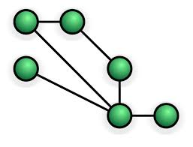





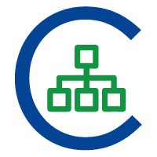

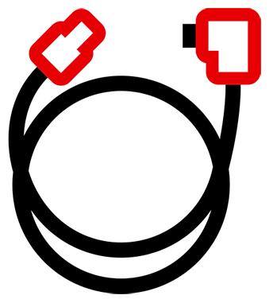
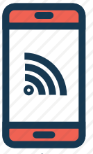


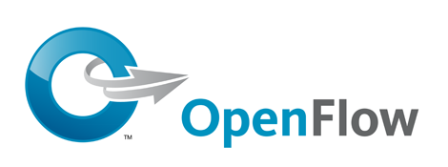


Introduction
Application Plane
Routing
Firewall
Load
Balancing
Intrusion Prevention
Network Visualization
Other
. . .
REST/Java APIs
Open Interface: needs control
Network Services
Virtual Network Resources
Topology Service | Entry Pushing
Routing Service | Device Management
Statistics Collection | Link Discovery
Switch Management | Other
Topology
Flow tables
Switches
Ports
Control Plane
Manage
Statistics
Traffic payloads
Config-
urations
VLANs
Hosts
Links
Devices
Other
OpenFlow Protocol
Data Plane
(Infrastructure)

Slide 4
Access control for SDN
Access control problem:
  Control which subjects (SDN apps) can access which objects (virtual network resources) for performing which actions (SDN operations).
Key issues for SDN include:
  Reducing network exposure to attack surface.
    Apply principle of least privileges for SDN apps.
    Minimize active permissions available for an SDN app.
  Facilitate administration of access control.
Challenges:
  Handling sessions of controller apps (no direct user interaction).
  Implementing access control with minimal change to controller’s code.

Slide 5
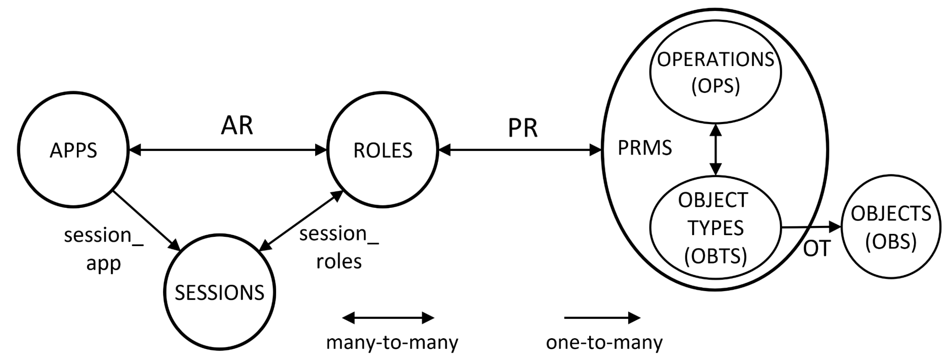
SDN-RBAC: Conceptual Model
Role examples:
Routing
Device Handler
Bandwidth Monitoring
Link Handler
Port Handler
etc.
Operation examples:
Get Port BW Statistics
Insert Flow to Switch
get All Devices
etc.
App examples:
Routing app
Load Balancing
Topology Visualizer
Network Debugger
etc.
Session examples
deep packet inspection session
transmission rate monitoring session
web-traffic filtering session
shortest path precomputation session
traffic redirection session
etc
Object Type example:
PORT- VLAN-5, PORT-VLAN-10
LINK-CS, LINK-ACC
HOST-TENANT-X, HOST-TENANT-Y
etc.

Slide 6
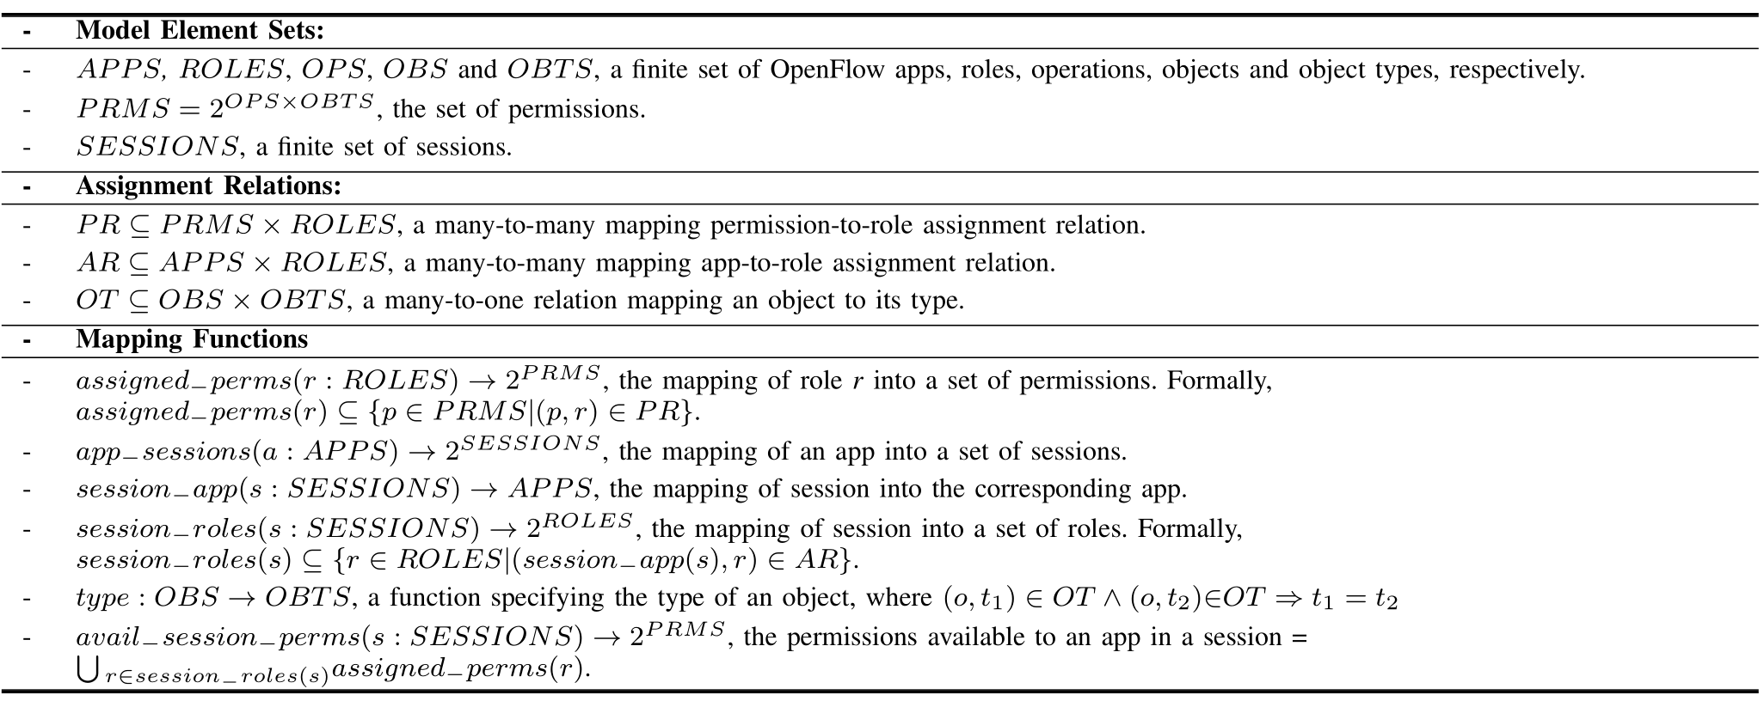
SDN-RBAC: Formal Definitions
Basic Element Sets
Assignment Relations
Mapping Functions
Used directly in checkAccess system function.

Slide 7
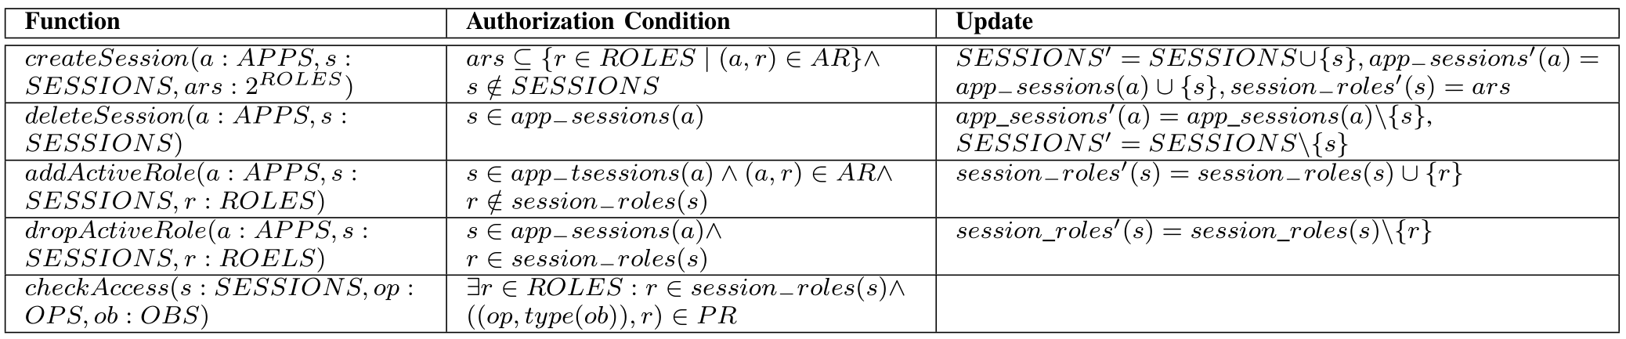
SDN-RBAC: Specifications of System Functions
Session Creation/Deletion
Adding/Dropping Active Role
Access Check
retrieving the object type

Slide 8
Sessions in SDN-RBAC
Two types:
  Atomic network sessions
    Self-contained task definition.
  Dependent network sessions.
    Inter-session dependency
    Conduct inter-session interaction at runtime.

Slide 9
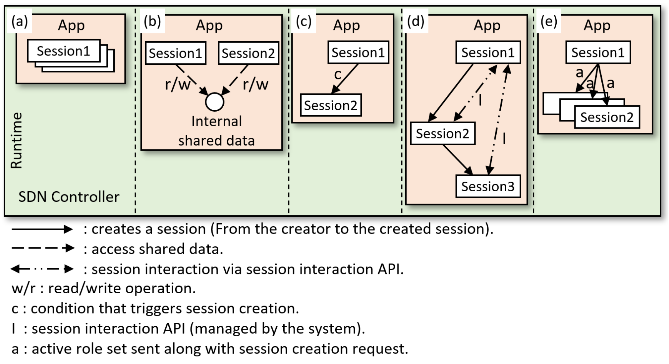
Methods for Inter-session Interaction for SDN-RBAC
Atomic sessions
Two sessions access shared data
Conditional session creation
Interaction via inter-session interaction APIs
Active role set sent from master to slave sessions

Slide 10
Methods for Inter-session Interaction for SDN-RBAC
      Examples of conditions for session creation:
      bandwidth consumption cap exceeded,
      new device detected,
      at system start-up.
      etc.
Session handling APIs usage examples:
      Getting names of all active sessions
      Getting active role set of a session.
      Getting session’s status.
        e.g., idle time, up time, etc.
      Passing information and notifications between sessions.
        e.g., results of calculations.

Slide 11
Session Handling Approaches
Who is responsible of specifying:
    (T) the tasks and corresponding sessions.
    (C) the condition for session creation/deletion.
    (A) the active role set.
    (R) role to be added/dropped during execution.
    (T) DD
    (C) SR
    (A) SR
    (R) SR
Session Handling Approaches
Developer-driven Approach
System-driven Approach
Session-driven Approach
    (T) DD
    (C) DD
    (A) DD
    (R) DD
    (T) CR
    (C) CR
    (A) CR
    (R) CR
Smart Sessions
Master Slave Sessions
DD – determined by developer at design-time.
CR – determined by controller at run-time.
SR – determined by session at run-time.

Slide 12
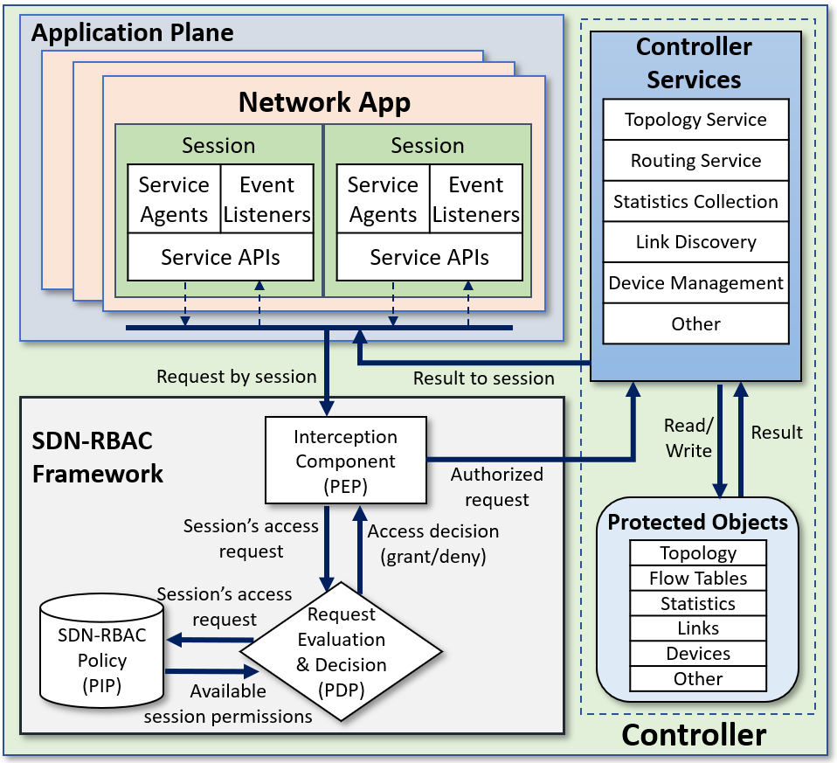
SDN-RBAC: System Architecture
AspectJ Hooking

Slide 13

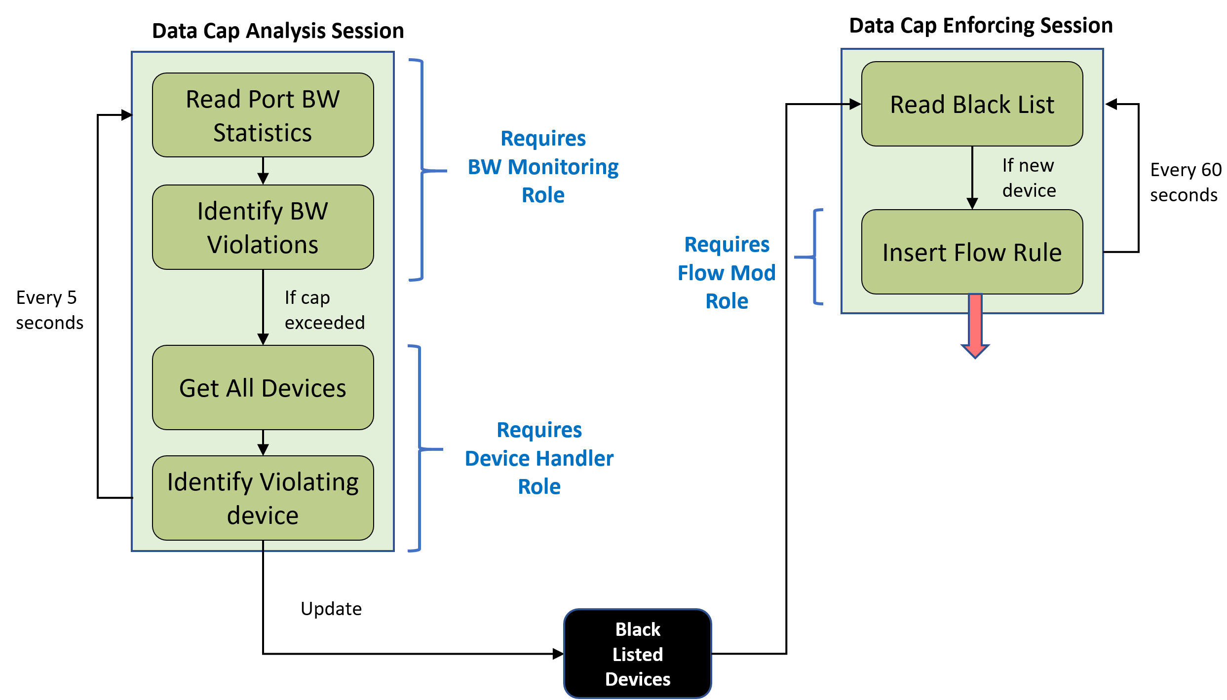
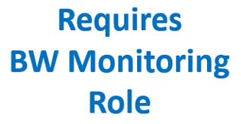
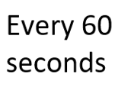
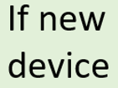
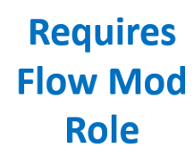
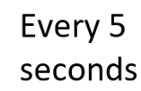
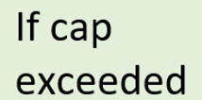
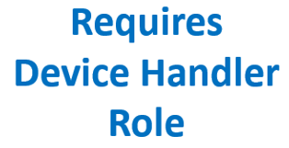
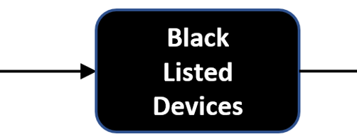

Use Case: Data Usage Manager
(A Multi-session App)
Black
Listed Devices

Slide 14
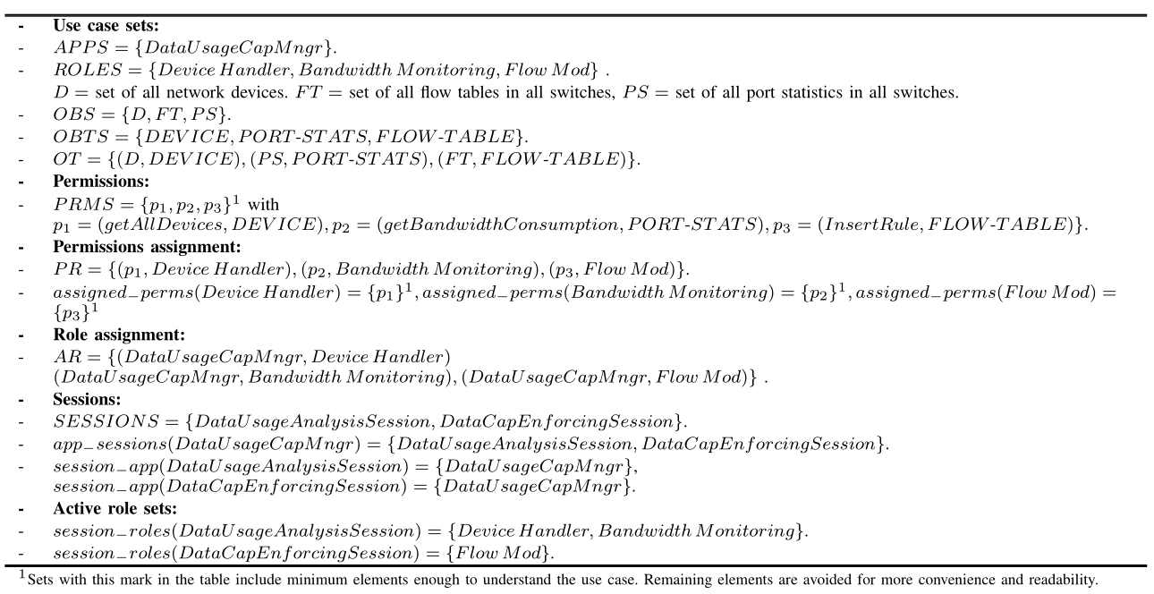
Use Case: Configuration in SDN-RBAC
3 roles
2 sessions
2 sessions
2 roles
1 role

Slide 15
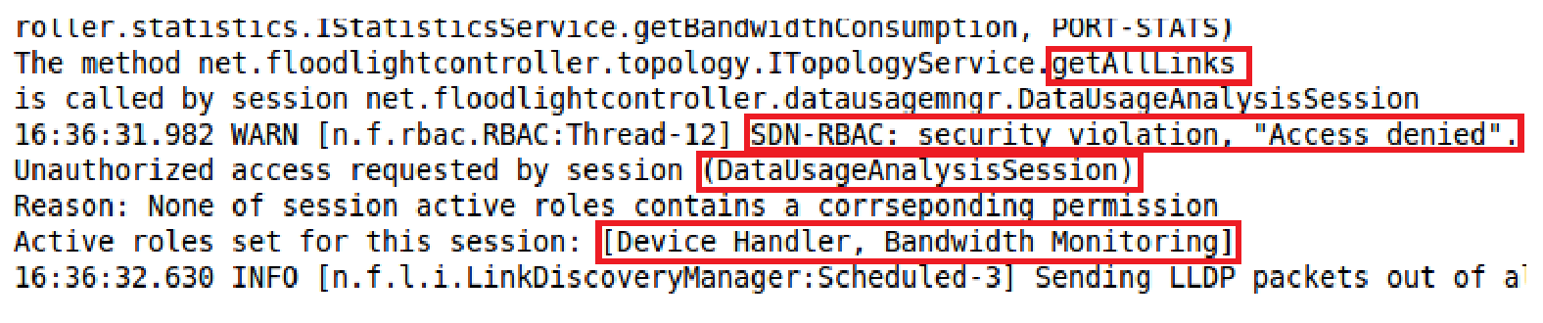
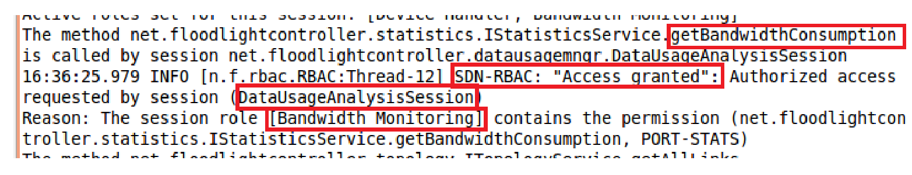
Demonstration in Floodlight:
Data Cap Manager App
Unauthorized
Snapshot1
Authorized
Snapshot2

Slide 16
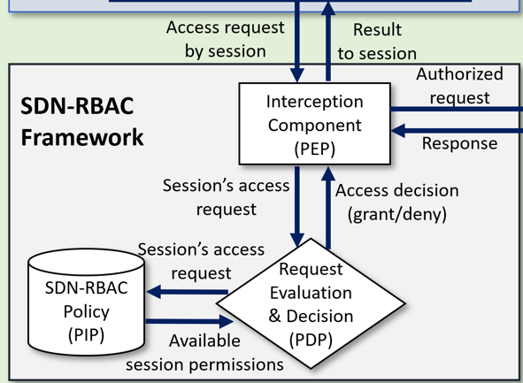
SDN-RBAC Average Decision Time
Timer Started
Timer Ended
Average execution time required by SDN-RBAC components to finish checking 50 operations with varying number of roles.
On average: 0.031 ms overhead for 50 operations.

Slide 17
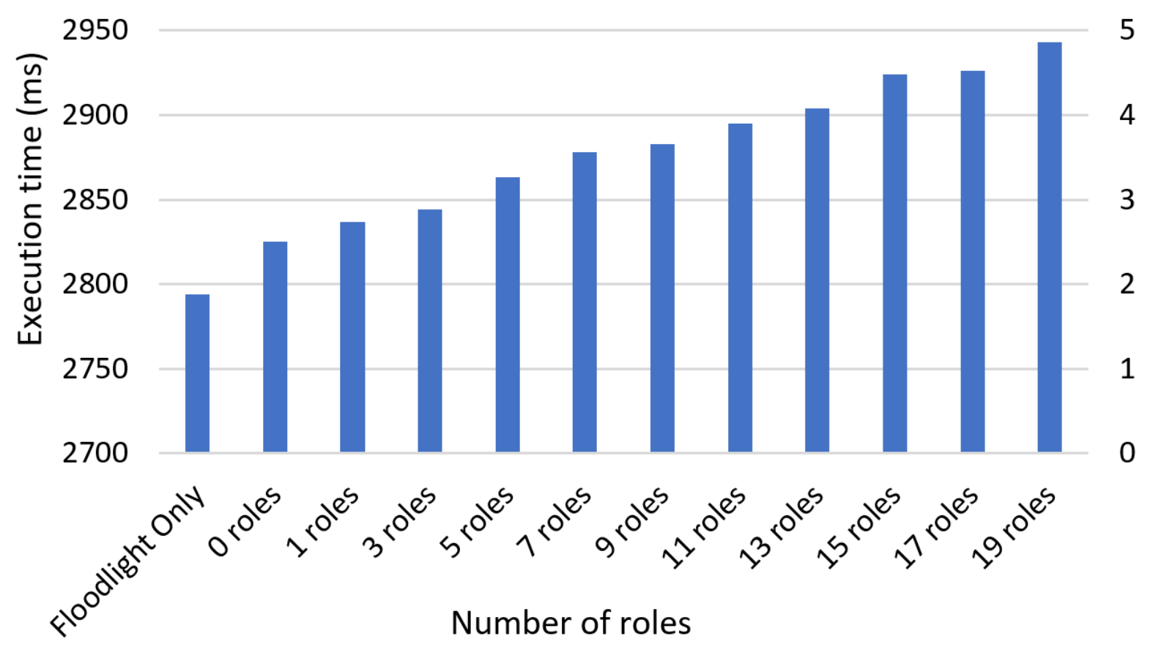
Controller with SDN-RBAC
Performance Evaluation
Average total execution time required to finish the 50 operations called 1000 times including and excluding SDN-RBAC.

Slide 18
Conclusion and Future Work
In this work:
A formal model (SDN-RBAC) for SDN controller apps.
Methods for Inter-session Interaction.
Different approaches for handling session instances of an app.
Implementation of the model, as proof-of-concept prototype, in Floodlight platform.
We used hooking techniques without any change to the code of Floodlight native modules.
We show the system’s usability using a test app with multi-session execution.
Performance evaluation with various number of roles.
Future research
  Hierarchical priority groups for conflict resolution between apps operations.
  Role-based administration of SDN-RBAC and its extensions.

