Slide 1
Analyzing Malware Detection Efficiency with Multiple Anti-Malware Programs
Dr. Jose A. Morales – Software Engineering Institute, Carnegie Mellon University
Dr. Shouhuai Xu – Department of Computer Science, University of Texas at San Antonio
Dr. Ravi Sandhu – Institute for Cyber Security, University of Texas at San Antonio

Slide 2
Introduction
Is 1 anti-malware enough? If NO how many are needed for sufficient detection?
Qualitatively test detection with multiple anti-malware COTS in a VM
Test for competence: achieved when an anti-malware detects and removes all malware from a machine
Discovered 3 COTS not enough to fully eradicate all malware on a machine
Conjecture more than 7 COTS may be needed to achieve competence

Slide 3
Contributions
Qualitatively show 1 anti-malware program insufficient to protect against all malware threats
Define the notion of an anti-malware being competent
Show 3 anti-malware engines not enough to disinfected a compromised system
Conclude the number of needed anti-malware programs too large to be practical

Slide 4
Anti-Malware Competence
An anti-malware is competent when:
  Detects & cleans all malware present on a system
Consumer trust of anti-malware capability based on inherent competence
Incompetence leads to
  system compromise
  Fundamental detection flaws in anti-malware

Slide 5
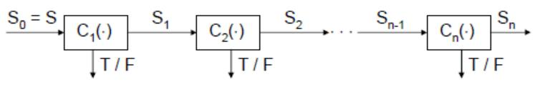
Testing for Competence
Tested 2 sets of 3 anti-malware products in sequence
  2 environments
    Clean start state
    Infected start state
Methodology:

Slide 6
DT & SDT
Anti-malware program C
State of a system S
DT(C_{i}(S_{i-1})) = True iff
  C_{i} detects an object in S_{i-1} as malware
  DT() tests C’s detection capability
SDT(C_{i}(S_{i})) = True iff
  C_{i} removes all detected malware in S_{i}
  SDT() tests C’s treatment effectiveness
Turnover Rate: SDT/DT=X%
  Shows treatment effectiveness of detected malicious objects

Slide 7
Achieving Competence
An anti-malware program C1 is competent, denoted by SDT(C₁(S))=T, if for every input S it holds that:
This can be extended to any number of C₁…C_{n}
Achieves complete detection and treatment thus is competent

Slide 8
Experiments
Attempt to establish competence to show:
  If 1 anti-malware is sufficient protection
  If not 1, then test how many anti-malware programs are needed to achieve sufficient protection against a diverse set of known malware
This measure facilitates confidence in consumers when buying these products.

Slide 9
Experiments
Tested two sets of 3 anti-malware programs each: (C₁(),C₂(),C₃()) as follows:
  1st set
    ESET,AVG,Zonealarm
  2nd set
    Kaspersky,G-data,Bitdefender
Tested all permutations of each set, 3!=6 cases per set
Two experiments
  carried out in Vmware
  running Windows 7 OS freshly installed to assure malware free enviroment
Diverse 500 malware samples
  worms, rootkints, bots, backdoors, password stealers, malware downloaders
  GFI sandbox repository 2010

Slide 10
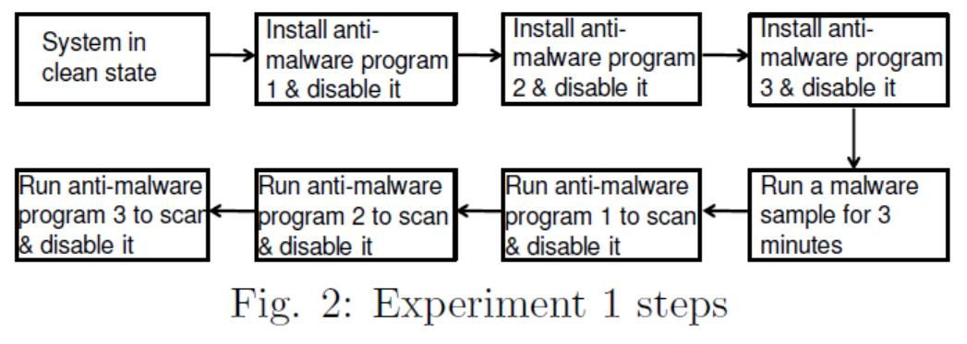
Experiments

Slide 11
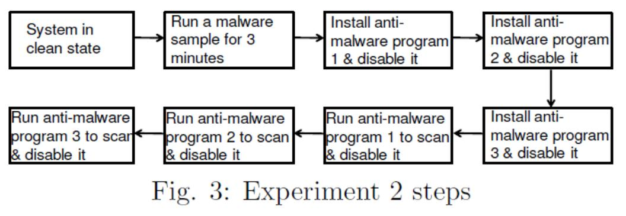
Experiments

Slide 12
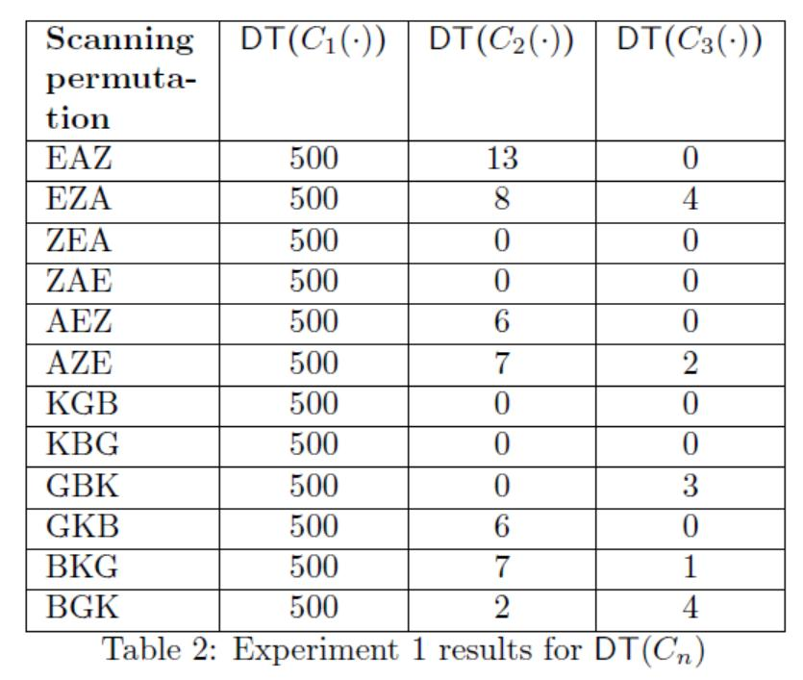
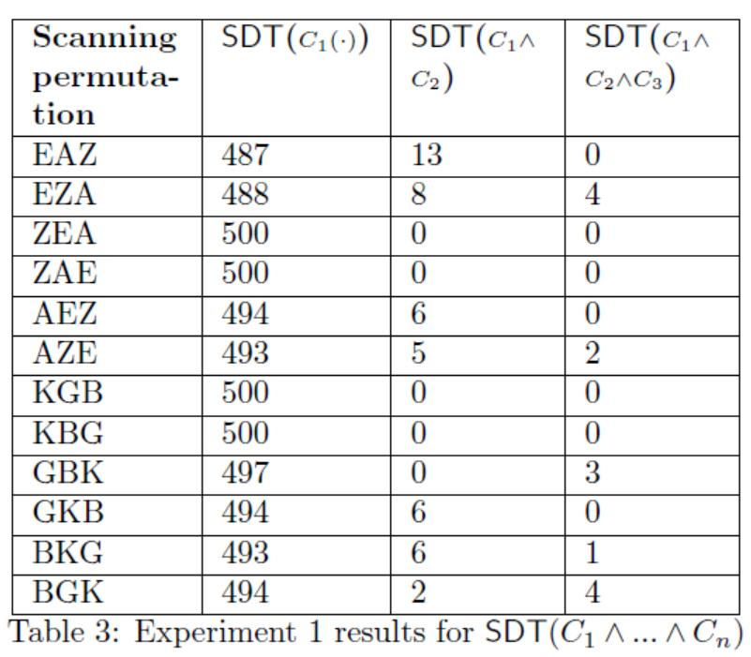
Experiments

Slide 13
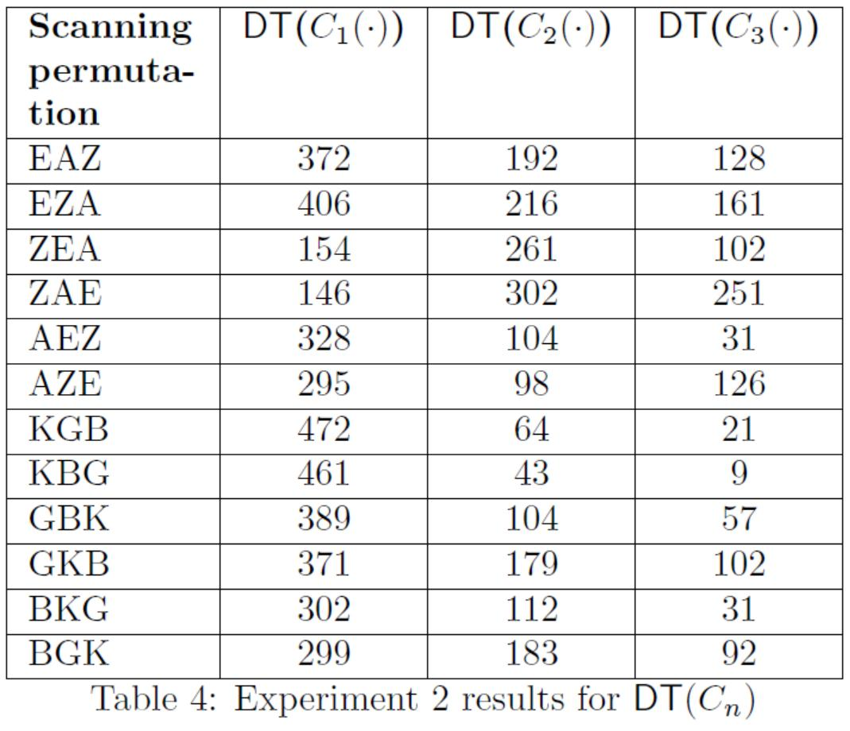
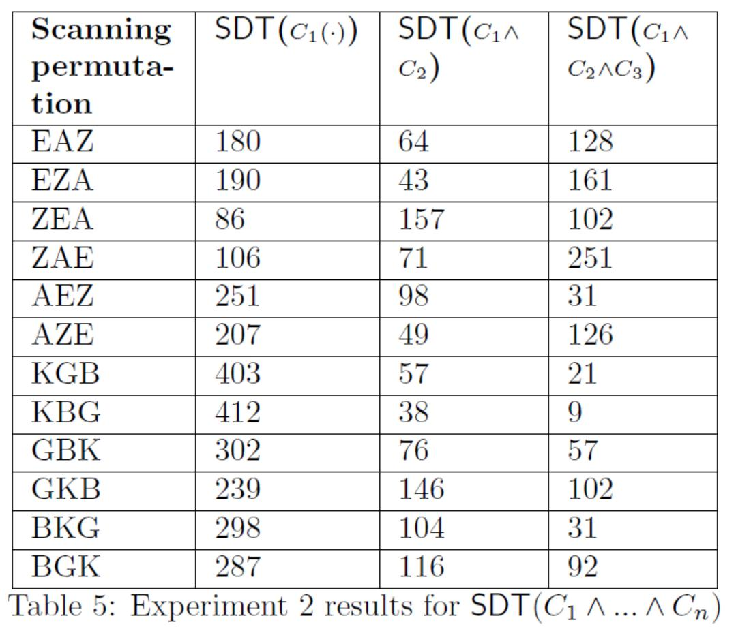
Experiments

Slide 14
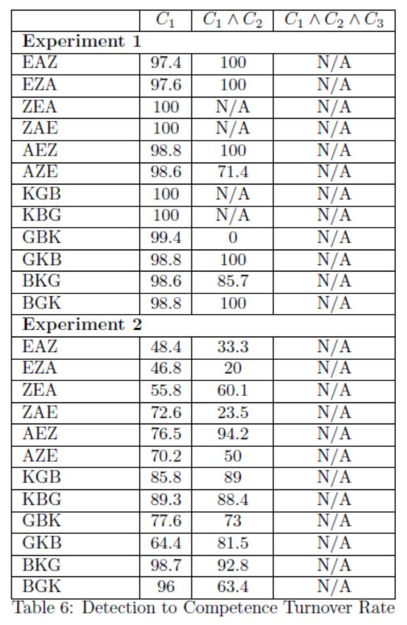
Experiments

Slide 15
Experiment Observations
Competence easily achieved with the anti-malware running in clean state
Combined detection power of multiple engines increases competence
Some cases where 3 engines not enough to achieve competence
Infected system facilitates anti-malware program instability
Anti-malware program installed in infected system may have higher false negatives
Tested anti-malware programs seem to lack a self-defense facilitating malware to compromise it
Malware running in a system may block access to resources needed by anti-malware facilitating a crash on execution

Slide 16
How Many Anti-Malware programs to deploy?
Based on experiment result:
  2 minimum for low protection
  3 for medium protection
  4-5 or more for high protection
Given current anti-malware technologies, achieving competence may be impractical
  Insufficient protection
  Facilitation of malware

Slide 17
Conclusions
Using multiple anti-malware programs does not seeming provide competence with diverse malware
Current anti-malware programs provide insufficient protection and are susceptible to malware compromise
Combining multiple anti-malware detection engines under one program may increase protection
Future work: rerun tests with larger sets of anti-malware programs seeking to achieve competence.

Slide 18
Questions?
¿Preguntas?
質問
ВопросыВопросы
Sawaal
Domande
Soru
ΕρωτήσειςΕρωτήσεις
問題

