Slide 1
CS 6393 Lecture 5
Usage Control (UCON)
or
ABAC on Steroids
Prof. Ravi Sandhu
Executive Director and Endowed Chair
February 26, 2016
ravi.sandhu@utsa.edu
www.profsandhu.com
© Ravi Sandhu
World-Leading Research with Real-World Impact!

Slide 2
Motivation
Traditional access control models are not adequate for today’s distributed, network-connected digital environment.
Authorization only – No obligation or condition based control
Decision is made before access – No ongoing control
No consumable rights - No mutable attributes
Rights are pre-defined and granted to subjects
© Ravi Sandhu
World-Leading Research with Real-World Impact!
2

Slide 3
Motivation
No access control model available to capture Digital Rights Management (DRM)
Control after dissemination
IPR protection
Need for a unified model that can encompass traditional access control models, DRM and other enhanced access control models from recent literature
© Ravi Sandhu
World-Leading Research with Real-World Impact!
3

Slide 4
Usage Control (UCON)
Scope
Encompass traditional access controls, trust management, digital rights management and more
For sensitive information protection, IPR protection, and privacy protection
Model
General purpose, policy neutral models
Policy is assumed to be given to the system
Transaction based control
Existence of right is determined when access is attempted by a subject (no predefined access matrix)
Attribute-based access control
© Ravi Sandhu
World-Leading Research with Real-World Impact!
4

Slide 5
Usage Control (UCON)
Security
Objectives
Security Architectures
© Ravi Sandhu
World-Leading Research with Real-World Impact!
5

Slide 6
Building UCON_{ABC} Models
Continuity
Decision can be made during usage for continuous enforcement
Mutability
Attributes can be updated as side-effects of subjects’ actions
© Ravi Sandhu
World-Leading Research with Real-World Impact!
6

Slide 7
Building UCON_{ABC} Models
Continuity
Decision can be made during usage for continuous enforcement
Mutability
Attributes can be updated as side-effects of subjects’ actions
© Ravi Sandhu
World-Leading Research with Real-World Impact!
7

Slide 8
Examples
Long-distance phone (pre-authorization with post-update)
Pre-paid phone card (ongoing-authorization with ongoing-update)
Pay-per-view (pre-authorization with pre-updates)
Click Ad every 30 minutes (ongoing-obligation with ongoing-updates)
Business Hours (pre-/ongoing-condition)
© Ravi Sandhu
World-Leading Research with Real-World Impact!
8

Slide 9
UCON_{ABC} Model Space
 | 0(Immutable) | 1(pre) | 2(ongoing) | 3(post)
preA | Y | Y | N | Y
onA | Y | Y | Y | Y
preB | Y | Y | N | Y
onB | Y | Y | Y | Y
preC | Y | N | N | N
onC | Y | N | N | N
N : Not applicable
© Ravi Sandhu
World-Leading Research with Real-World Impact!
9

Slide 10
A Family of UCON_{ABC} Core Models
© Ravi Sandhu
World-Leading Research with Real-World Impact!
10

Slide 11
UCON_{preA}
Online content distribution service
Pay-per-view (pre-update)
Metered payment (post-update)
© Ravi Sandhu
World-Leading Research with Real-World Impact!
11

Slide 12
UCON_{onA}
Pay-per-minutes (pre-paid Phone Card)
© Ravi Sandhu
World-Leading Research with Real-World Impact!
12

Slide 13
UCON_{preA}: pre-Authorizations Model
UCON_{preA0}
S, O, R, ATT(S), ATT(O) and preA (subjects, objects, rights, subject attributes, object attributes, and pre-authorizations respectively);
allowed(s,o,r) ⇒ preA(ATT(s),ATT(o),r)
UCON_{preA1}
preUpdate(ATT(s)),preUpdate(ATT(o))
UCON_{preA3}
postUpdate(ATT(s)),postUpdate(ATT(o))
© Ravi Sandhu
World-Leading Research with Real-World Impact!
13

Slide 14
UCON_{preA0}: MAC Example
L is a lattice of security labels with dominance relation ≥
clearance: S → L
classification: O → L
ATT(S) = {clearance}
ATT(O) = {classification}
allowed(s,o,read) ⇒ clearance(s) ≥ classification(o)
allowed(s,o,write) ⇒ clearance(s) ≤ classification(o)
© Ravi Sandhu
World-Leading Research with Real-World Impact!
14

Slide 15
DAC in UCON: with ACL (UCON_{preA0})
N is a set of identity names
id : S → N, one to one mapping
ACL : O → 2^{N x R}, n is authorized to do r to o
ATT(S)= {id}
ATT(O)= {ACL}
allowed(s,o,r) ⇒ (id(s),r) ∈ ACL(o)
© Ravi Sandhu
World-Leading Research with Real-World Impact!
15

Slide 16
RBAC in UCON: RBAC₁ (UCON_{preA0})
P = {(o,r)}
ROLE is a partially ordered set of roles with dominance relation ≥
actRole: S → 2^{ROLE}
Prole: P → 2^{ROLE}
ATT(S) = {actRole}
ATT(O) = {Prole}
allowed(s,o,r) ⇒ ∃role ∈ actRole(s), ∃role’ ∈ Prole(o,r), role ≥ role’
© Ravi Sandhu
World-Leading Research with Real-World Impact!
16

Slide 17
DRM in UCON: Pay-per-use with pre-paid credit (UCON_{preA1})
M is a set of money amounts
credit: S → M
value: O x R → M
ATT(s): {credit}
ATT(o,r): {value}
allowed(s,o,r) ⇒ credit(s) ≥ value(o,r)
preUpdate(credit(s)): credit(s) = credit(s) - value(o,r)
© Ravi Sandhu
World-Leading Research with Real-World Impact!
17

Slide 18
UCON_{preA3} : DRM Example
Membership-based metered payment
M is a set of money amount
ID is a set of membership identification numbers
TIME is a current usage minute
member: S → ID
expense: S → M
usageT: S → TIME
value: O x R → M (a cost per minute of r on o)
ATT(s): {member, expense, usageT}
ATT(o,r): {valuePerMinute}
allowed(s,o,r) ⇒ member(s) ≠ ∅
postUpdate(expense(s)): expense(s) = expense(s) + (value(o,r) x usageT(s))
© Ravi Sandhu
World-Leading Research with Real-World Impact!
18

Slide 19
UCON_{onA}: ongoing-Authorizations Model
UCON_{onA0}
S, O, R, ATT(S), ATT(O) and onA;
allowed(s,o,r) ⇒ true;
Stopped(s,o,r) ⇐ ¬onA(ATT(s),ATT(o),r)
UCON_{onA1}, UCON_{onA2}, UCON_{onA3}
preUpdate(ATT(s)),preUpdate(ATT(o))
onUpdate(ATT(s)),onUpdate(ATT(o))
postUpdate(ATT(s)),postUpdate(ATT(o))
Examples
Certificate Revocation Lists
revocation based on starting time, longest idle time, and total usage time
© Ravi Sandhu
World-Leading Research with Real-World Impact!
19

Slide 20
UCON_{B}
Free Internet Service Provider
Watch Ad window (no update)
Click ad within every 30 minutes (ongoing update)
© Ravi Sandhu
World-Leading Research with Real-World Impact!
20

Slide 21
UCON_{preB0}: pre-oBligations w/ no update
S, O, R, ATT(S), and ATT(O);
OBS, OBO and OB (obligation subjects, obligation objects, and obligation actions, respectively);
preB and preOBL (pre-obligations predicates and pre-obligation elements, respectively);
preOBL ⊆ OBS x OBO x OB;
preFulfilled: OBS x OBO x OB → {true,false};
getPreOBL: S x O x R → 2^{preOBL}, a function to select pre-obligations for a requested usage;
preB(s,o,r) = Λ(obs_i,obo_i,ob_i) ∈ getPreOBL(s,o,r) preFulfilled(obs_{i},obo_{i},ob_{i});
preB(s,o,r) = true by definition if getPreOBL(s,o,r)=∅;
allowed(s,o,r) ⇒ preB(s,o,r).
Example: License agreement for a whitepaper download
© Ravi Sandhu
World-Leading Research with Real-World Impact!
21

Slide 22
UCON_{onB0}: ongoing-oBligations w/ no update
S, O, R, ATT(S), ATT(O), OBS, OBO and OB;
T, a set of time or event elements;
onB and onOBL (on-obligations predicates and ongoing-obligation elements, respectively);
onOBL ⊆ OBS x OBO x OB x T;
onFulfilled: OBS x OBO x OB x T→ {true,false};
getOnOBL: S x O x R → 2^{onOBL}, a function to select ongoing-obligations for a requested usage;
onB(s,o,r) = Λ(obs_i,obo_i,ob_i, t_i) ∈ getOnOBL(s,o,r) onFulfilled(obs_{i},obo_{i},ob_{i} ,t_{i});
onB(s,o,r) = true by definition if getOnOBL(s,o,r)=∅;
allowed(s,o,r) ⇒ true;
Stopped(s,o,r) ⇐ ¬ onB(s,o,r).
Example: Free ISP with mandatory ad window
© Ravi Sandhu
World-Leading Research with Real-World Impact!
22

Slide 23
UCON_{C}
Location check at the time of access request
Accessible only during business hours
© Ravi Sandhu
World-Leading Research with Real-World Impact!
23

Slide 24
UCON_{preC0}: pre-Condition model
S, O, R, ATT(S), and ATT(O);
preCON (a set of pre-condition elements);
preConChecked: preCON → {true,false};
getPreCON: S x O x R → 2^{preCON};
preC(s,o,r) = Λ_{preCon_i ∈ getPreCON(s,o,r)} preConChecked(preCon_{i});
allowed(s,o,r) ⇒ preC(s,o,r).
Example: location checks at the time of access requests
© Ravi Sandhu
World-Leading Research with Real-World Impact!
24

Slide 25
UCON_{onC0}: ongoing-Condition model
S, O, R, ATT(S), and ATT(O);
onCON (a set of on-condition elements);
onConChecked: onCON → {true,false};
getOnCON: S x O x R → 2^{onCON};
onC(s,o,r) = Λ_{onCon_i ∈ getOnCON(s,o,r)} onConChecked(onCon_{i});
allowed(s,o,r) ⇒ true;
Stopped(s,o,r) ⇐ ¬onC(s,o,r)
Example: accessible during office hour
© Ravi Sandhu
World-Leading Research with Real-World Impact!
25

Slide 26
UCON_{ABC}
Free ISP
Membership is required (pre-authorization)
Have to click Ad periodically while connected (on-obligation, on-update)
Free member: no evening connection (on-condition), no more than 50 connections (pre-update) or 100 hours usage per month (post-updates)
© Ravi Sandhu
World-Leading Research with Real-World Impact!
26

Slide 27
Beyond the UCON_{ABC} Core Models
© Ravi Sandhu
World-Leading Research with Real-World Impact!
27

Slide 28
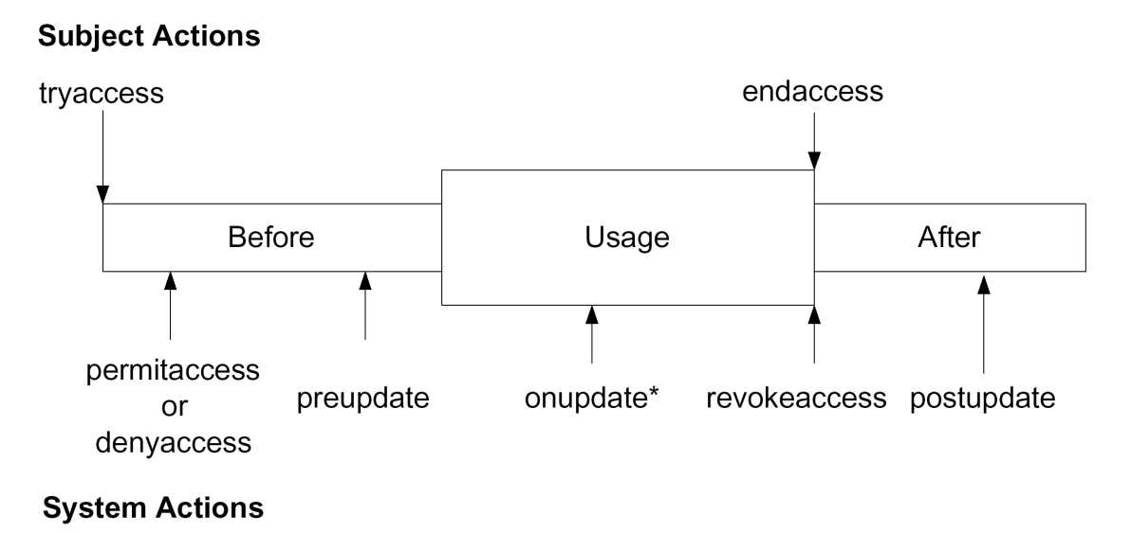
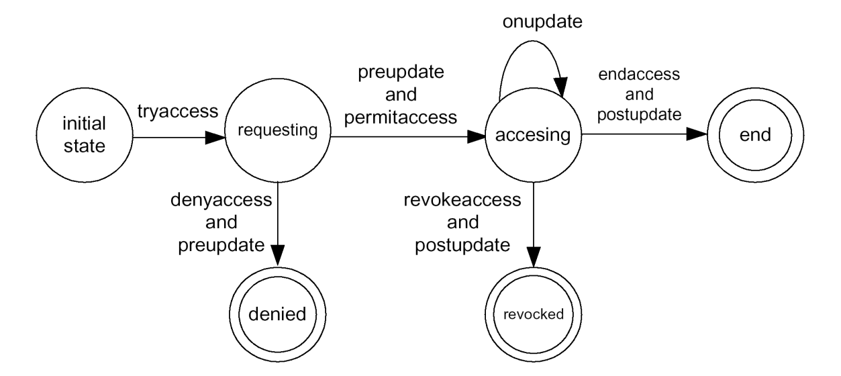
Logic Model of UCON
Actions: boolean expressions built from attributes in two states.
Alice.credit’=Alice.credit - $50.0
Two types of actions:
Control actions: change the state of single usage process
Actions performed by the subject
Actions performed by the system
Obligation actions:
Actions that have to be performed before or during an access.
May or may not be performed by the requesting subject and on the target object.
© Ravi Sandhu
World-Leading Research with Real-World Impact!
28

Slide 29
Summary of UCON
Coined the concept of Usage Control for modern computing systems
Developed A family of UCON_{ABC} core models for Usage Control (UCON) to unify traditional access control models, DRM, and other modern enhanced models.
UCON_{ABC} model integrates authorizations, obligations, conditions, as well as continuity and mutability properties.
© Ravi Sandhu
World-Leading Research with Real-World Impact!
29

Slide 30
Discuss Pretschner 2006 paper
© Ravi Sandhu
World-Leading Research with Real-World Impact!

