Slide 1
CS 6393 Lecture 1
Cyber Security
A Personal Perspective
Prof. Ravi Sandhu
Executive Director and Endowed Chair
January 15, 2016
ravi.sandhu@utsa.edu
www.profsandhu.com
© Ravi Sandhu
World-Leading Research with Real-World Impact!

Slide 2
Prognosis
Cyberspace will become orders of magnitude more complex and confused very quickly
Cyber and physical distinction will disappear
Threats will go beyond money to physical harm and danger to life and body
Overall this is a very positive development and will enrich human society
It will be messy but need not be chaotic!
Cyber security research and practice are loosing ground
© Ravi Sandhu
World-Leading Research with Real-World Impact!
2

Slide 3
Security Objectives
INTEGRITY
modification
AVAILABILITY
access
CONFIDENTIALITY
disclosure
© Ravi Sandhu
World-Leading Research with Real-World Impact!
3

Slide 4
Security Objectives
USAGE
purpose
INTEGRITY
modification
AVAILABILITY
access
CONFIDENTIALITY
disclosure
© Ravi Sandhu
World-Leading Research with Real-World Impact!
4

Slide 5
Security Objectives
USAGE
purpose
USAGE
INTEGRITY
modification
AVAILABILITY
access
CONFIDENTIALITY
disclosure
© Ravi Sandhu
World-Leading Research with Real-World Impact!
5

Slide 6
Security Objectives
Single Enterprise
owns all the information
employs all the users
Multiple Interacting Parties
no one owns all the information
no one can unilaterally impose policy on all the users
More than 2 decades of encryption versus privacy debate
© Ravi Sandhu
World-Leading Research with Real-World Impact!
6

Slide 7
Cyber Security Scope
Computer security
Information security =
Computer security + Communications security
Information assurance
Mission assurance
Includes cyber physical
© Ravi Sandhu
World-Leading Research with Real-World Impact!
7

Slide 8
Fundamental Challenge
What is fundamental to cyber security?
Where are the boundaries of a cyber system?
What are the goals of cyber security?
© Ravi Sandhu
World-Leading Research with Real-World Impact!
8

Slide 9
Cyber Security Goal
Enable system designers and operators to say:
This system is secure
© Ravi Sandhu
World-Leading Research with Real-World Impact!
9

Slide 10
Cyber Security Goal
Enable system designers and operators to say:
This system is secure
There is an infinite supply of attacks
Not attainable
© Ravi Sandhu
World-Leading Research with Real-World Impact!
10

Slide 11
Cyber Security Goal
Enable system designers and operators to say:
This system is secure enough
Many successful examples
© Ravi Sandhu
World-Leading Research with Real-World Impact!
11

Slide 12
The ATM Paradox
The ATM (Automatic Teller Machine) system is
secure enough
global in scope
Not attainable via current cyber security science, engineering, doctrine
not studied as a success story
Similar paradoxes apply to
on-line banking
e-commerce payments
© Ravi Sandhu
World-Leading Research with Real-World Impact!
12

Slide 13
High Assurance Cyber Security
US President’s nuclear football
Secret formula for Coca-Cola
© Ravi Sandhu
World-Leading Research with Real-World Impact!
13

Slide 14
Cyber Security Goal
Enable system designers and operators to say:
This system is secure enough
In an innovative ecosystem the innovation drive will ensure that the bar for enough will be fairly low
© Ravi Sandhu
World-Leading Research with Real-World Impact!
14

Slide 15
Productivity-Security
Cyber Security is all about tradeoffs
Productivity
Security
Let’s build it
Cash out the benefits
Next generation can secure it
Let’s not build it
Let’s bake in super-security to
make it unusable/unaffordable
Let’s sell unproven solutions
There is a middle ground
We don’t know how to predictably find it
© Ravi Sandhu
World-Leading Research with Real-World Impact!
15

Slide 16
Grand Challenges
Develop a scientific discipline
to predictably find the sweet spots for different application and mission contexts
to predictably find, incentivize and deploy microsec that leads to desirable macrosec outcomes
that can be meaningfully taught in Universities at all levels: BS, MS, PhD
Prognosis
we shall succeed (we have no choice)
but we need to change to succeed
© Ravi Sandhu
World-Leading Research with Real-World Impact!
16

Slide 17
Butler Lampson Paraphrased (I think)
Computer scientists could never have designed the web because they would have tried to make it work.
But the Web does “work.”
What does it mean for the Web to “work”?
Security geeks could never have designed the ATM network because they would have tried to make it secure.
But the ATM network is “secure.”
What does it mean for the ATM network to be “secure”?
© Ravi Sandhu
World-Leading Research with Real-World Impact!
17

Slide 18
Bellovin’s Slides
digression
© Ravi Sandhu
World-Leading Research with Real-World Impact!

Slide 19
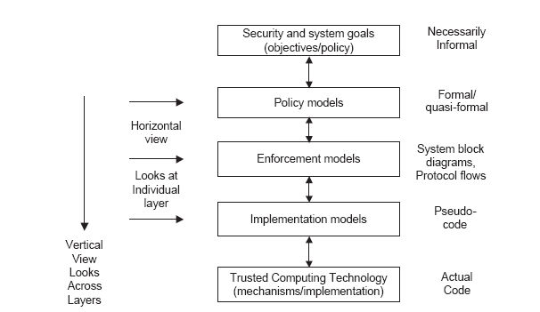
PEI Models
Idealized
Enforceable
(Approximate)
Codeable
© Ravi Sandhu
World-Leading Research with Real-World Impact!
19

Slide 20
Limits on Security
Trojan horse/malware
Covert channels/side channels
Inference
Analog hole
Assured enforcement
Privilege escalation
Policy comprehension and analysis
Predicting value and future usage of data
…..
© Ravi Sandhu
World-Leading Research with Real-World Impact!
20

Slide 21
Reference Material
digression
© Ravi Sandhu
World-Leading Research with Real-World Impact!

