Slide 1
CS 5323
Introduction to Cyber Security
Prof. Ravi Sandhu
Executive Director and Endowed Chair
Lecture 1
ravi.utsa@gmail.com
www.profsandhu.com
© Ravi Sandhu
World-Leading Research with Real-World Impact!

Slide 2
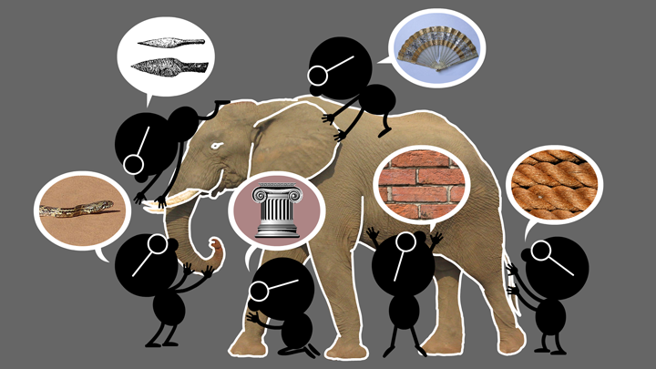
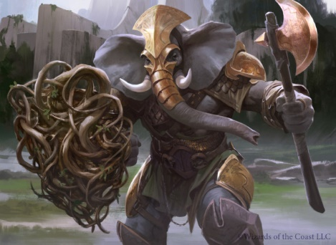
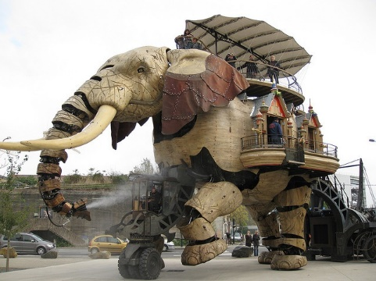
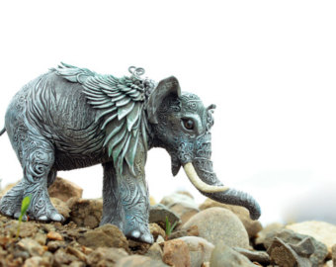
Natural vs Cyber Science
Elephant Problem
Cyber-Elephant Problem
The cyber-elephant problem requires Applied and Basic research Combined (ABC)
* The New ABCs of Research, Ben Schneiderman, 2016
© Ravi Sandhu
World-Leading Research with Real-World Impact!
2

Slide 3
Cyber Security is Dynamic
“My dear, here we must run as fast as we can, just to stay in place. And if you wish to go anywhere you must run twice as fast as that.”
― Lewis Carroll, Alice in Wonderland
© Ravi Sandhu
World-Leading Research with Real-World Impact!
3

Slide 4
Prognosis
Cyberspace will become orders of magnitude more complex and confused very quickly
Cyber and physical distinction will blur
Threats will go beyond money to physical harm and danger to life and body
Overall this is a very positive development and will enrich human society
It will be messy but need not be chaotic!
Cyber security research and practice are loosing ground
© Ravi Sandhu
World-Leading Research with Real-World Impact!
4

Slide 5
Security Objectives
INTEGRITY
modification
AVAILABILITY
access
CONFIDENTIALITY
disclosure
© Ravi Sandhu
World-Leading Research with Real-World Impact!
5

Slide 6
Security Objectives
Control of read and write is fundamental to all three
INTEGRITY
modification
AVAILABILITY
access
CONFIDENTIALITY
disclosure
© Ravi Sandhu
World-Leading Research with Real-World Impact!
6

Slide 7
Security Objectives
Cannot have it all
Need to compromise
INTEGRITY
modification
AVAILABILITY
access
CONFIDENTIALITY
disclosure
© Ravi Sandhu
World-Leading Research with Real-World Impact!
7

Slide 8
Security is Secondary
Cannot have it all
Need to reconcile
with non-Security Objectives
Cost
Convenience
CIA
Growth
Safety
© Ravi Sandhu
World-Leading Research with Real-World Impact!
8

Slide 9
Security Objectives
USAGE
purpose
INTEGRITY
modification
AVAILABILITY
access
CONFIDENTIALITY
disclosure
© Ravi Sandhu
World-Leading Research with Real-World Impact!
9

Slide 10
Security Objectives
USAGE
purpose
Covers privacy and intellectual property protection
INTEGRITY
modification
AVAILABILITY
access
CONFIDENTIALITY
disclosure
© Ravi Sandhu
World-Leading Research with Real-World Impact!
10

Slide 11
Security Objectives
USAGE
purpose
USAGE
INTEGRITY
modification
AVAILABILITY
access
CONFIDENTIALITY
disclosure
© Ravi Sandhu
World-Leading Research with Real-World Impact!
11

Slide 12
Security Objectives
Single Enterprise
owns all the information
employs all the users
Multiple Interacting Parties
no one owns all the information
no one can unilaterally impose policy on all the users
© Ravi Sandhu
World-Leading Research with Real-World Impact!
12

Slide 13
Cyber Security Scope
Computer security
Information security =
Computer security + Communications security
Information assurance
Mission assurance
Includes cyber physical
© Ravi Sandhu
World-Leading Research with Real-World Impact!
13

Slide 14
Cyber Security Goal
Enable system designers and operators to say:
This system is secure
© Ravi Sandhu
World-Leading Research with Real-World Impact!
14

Slide 15
Cyber Security Goal
Enable system designers and operators to say:
This system is secure
Conflicting objectives need political and social compromise
There is an infinite and escalating supply of attacks
Not attainable
© Ravi Sandhu
World-Leading Research with Real-World Impact!
15

Slide 16
Cyber Security Goal
Enable system designers and operators to say:
This system is secure enough OR This system is as secure as it needs to be and no more
Many successful examples
© Ravi Sandhu
World-Leading Research with Real-World Impact!
16

Slide 17
Cyber Security is Dynamic
“My dear, here we must run as fast as we can, just to stay in place. And if you wish to go anywhere you must run twice as fast as that.”
― Lewis Carroll, Alice in Wonderland
© Ravi Sandhu
World-Leading Research with Real-World Impact!
17

Slide 18
Low Assurance Systems
The ATM (Automatic Teller Machine) system is
secure enough
global in scope
Similarly
on-line banking
e-commerce payments
© Ravi Sandhu
World-Leading Research with Real-World Impact!
18

Slide 19
High Assurance Systems
US President’s nuclear football
Secret formula for Coca-Cola
© Ravi Sandhu
World-Leading Research with Real-World Impact!
19

Slide 20
Limits to Security
Analog hole
Inference
Side channels
Insider threat
Detection is impossible
Protection is impossible
…..
© Ravi Sandhu
World-Leading Research with Real-World Impact!
20

Slide 21
Cyber Security Landscape
Objectives
POLICY
ATTACKS
Security
Objectives
POLICY
ATTACKS
Why?
What?
Why?
What?
Enable
Respond
Enforce
Defend
PROTECT
DETECT
PROTECT
DETECT
Complement
Mechanisms
Security
Mechanisms
How?
© Ravi Sandhu
World-Leading Research with Real-World Impact!
21

Slide 22
Cyber Security Landscape
Objectives
POLICY
ATTACKS
Security
Objectives
POLICY
ATTACKS
Why?
What?
Why?
What?
Enable
Respond
Technology
Domain
Enforce
Defend
PROTECT
DETECT
PROTECT
DETECT
Complement
Mechanisms
Security
Mechanisms
How?
© Ravi Sandhu
World-Leading Research with Real-World Impact!
22

